Slide 1

Applications of
Acoustic Metamaterials
Ryan Hill, MSEE student
Matias Mendieta, EE Undergraduate
Patrick Bruce, EE Undergraduate
Ed Stokes, EE Professor
Contact: Ed Stokes
ebstokes@uncc.edu
704-687-8425

Slide 2
Outline
Objectives
Co-funding and Intellectual Property
New hardware and capabilities
BSWA Impedance Tubes
Davis Instruments Anemometer
Extech Barometric/Temperature/Relative Humidity Sensor
3D Printing Capabilities in UNC Charlotte Optics Center
Comsol Multiphysics® LiveLinkTM for SolidWorks®
Technology review
2017 prototype samples
Current samples with optimized resonators
New samples with flow enhancement
Comsol Multiphysics® simulations

Slide 3
Objectives
The objective of the current work is to develop an acoustic metamaterial filter for cooling fans that reduces audible noise while still allowing sufficient flow for convective cooling. The current approach uses 3D printed arrays of optimized Helmholtz resonators along with a typical cooling fan used by a Center member company in system applications.
Co-funding & Intellectual property
There is no co-funding of this work outside the Center and UNC Charlotte
One major piece of equipment (new Impedance tube) was purchased jointly with both UNC Charlotte and CfM funds
An invention disclosure is in preparation based on the experimental results presented here today

Slide 4
2018-19 budget and timeline
Direct Cost |  | Support
Students |  | 20,000
Tuition |  | 8,000
Supplies |  | 1,874
Software* |  | 1,990
Travel |  | 2,500
Equipment |  | 1,000
Publication |  | 1,000
Subtotal |  | 36,364
Indirect Cost
Overhead |  | 3,636
Total |  | 40,000
Regular contact with industrial Center sponsor through regular telephone conferences and e-mails.
July-September 2018
Design, simulate, and fabricate metamaterial that has a lower frequency absorption targeting individual fan noise frequencies
File invention disclosure
October-December 2018 – Design, simulate, and fabricate metamaterial that has a broadband absorption for all target fan frequencies
January-March 2019 - Design, simulate, and fabricate metamaterial that has broadband absorption with particle flow
April-June 2019
Write-up results for publication in appropriate journals and conference proceedings.
MSEE Thesis for Ryan Hill

Slide 5
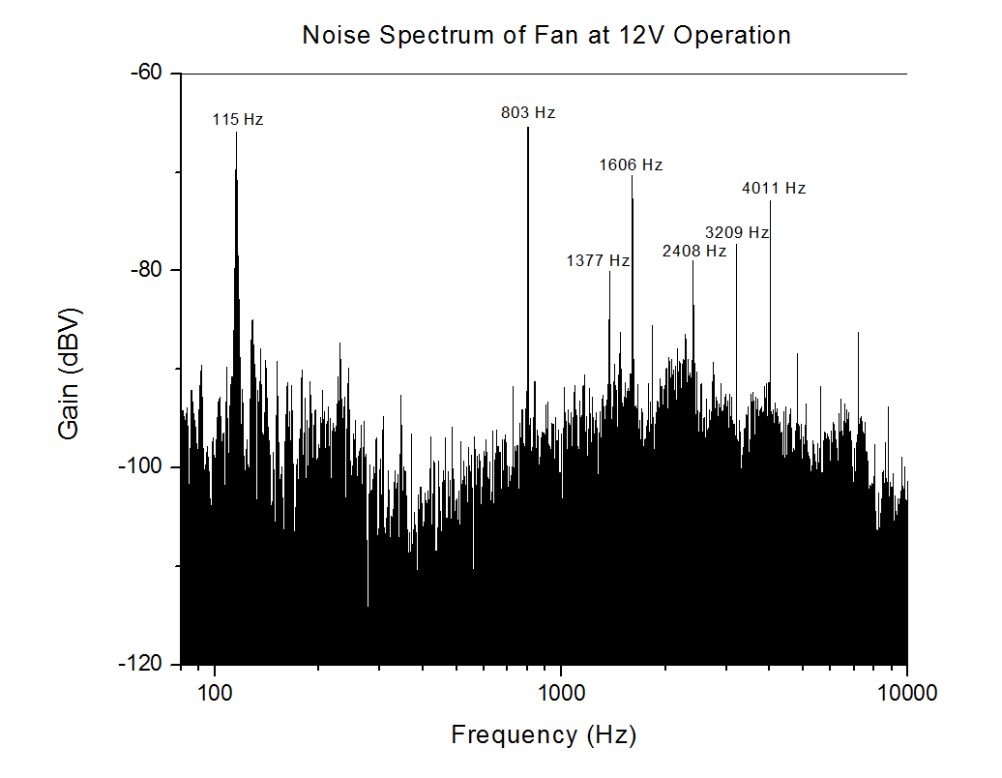
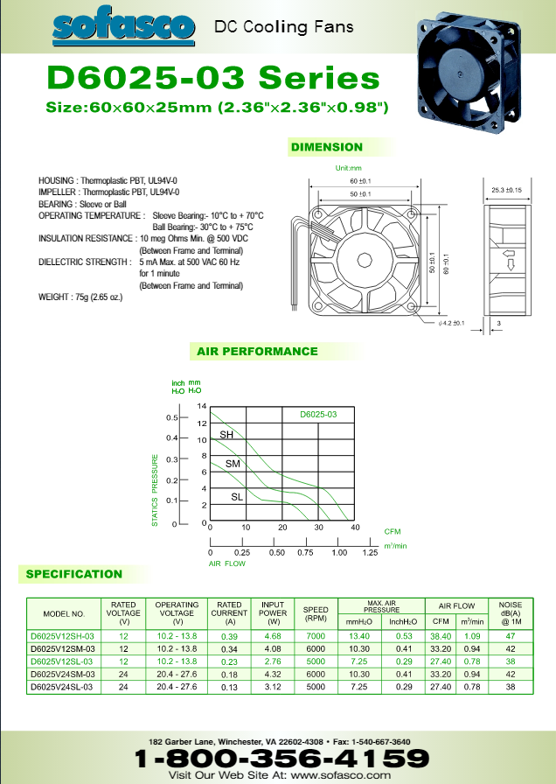

Typical Cooling Fan Data
Seven Fan Blade at 7200 RPM
$Fan Rotation Frequency \left(FRF\right)=\frac{Fan RPM}{60 \frac{s}{min}}$
$Blade Pass Frequency(BPF)=\frac{No. of Blades ∗Fan RPM}{60 \frac{s}{min}}$
Peak | Calculated | Measured
1 | 117 Hz | 115 Hz
2 | 817 Hz | 803 Hz
3 | N/a | 1377 Hz
4 | 1634 Hz | 1606 Hz
5 | 2451 Hz | 2408 Hz
6 | 3268 Hz | 3209 Hz
7 | 4085 Hz | 4011 Hz

Slide 6
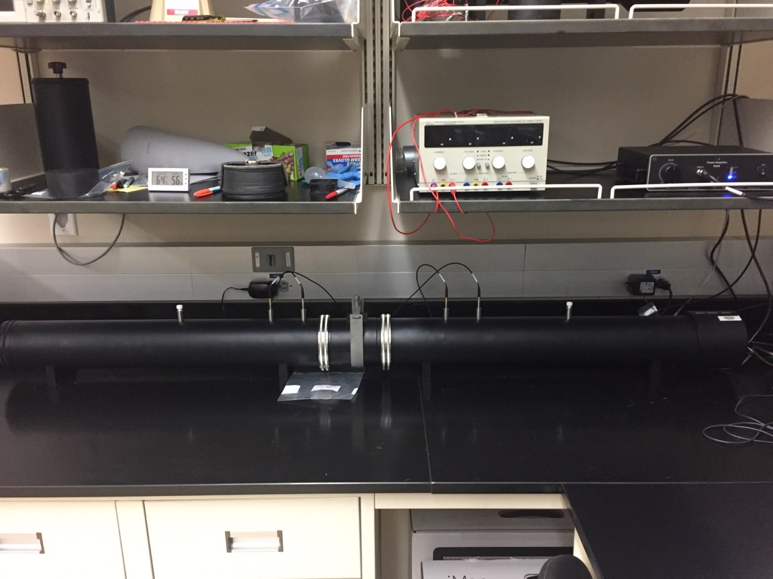
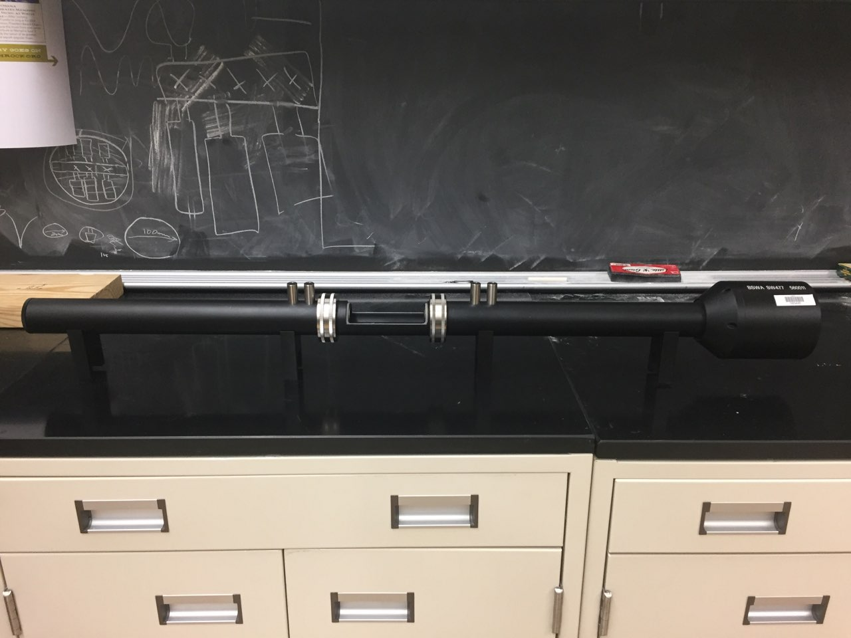
New BSWA Impedance Tube - Purchased in summer 2018
Diameter | 100 [mm] | 30 [mm]
Part Number | SW422 | SW477
Operating Frequency | 63[hz] – 1600 [hz] | 1000 [hz] – 6100 [hz]
BSWA SW422 Impedance Tube
Microphones
Speaker
Sample
Holder
BSWA SW477 Impedance Tube
From BSWA Impedance Tubes product literature, version 201008

Slide 7
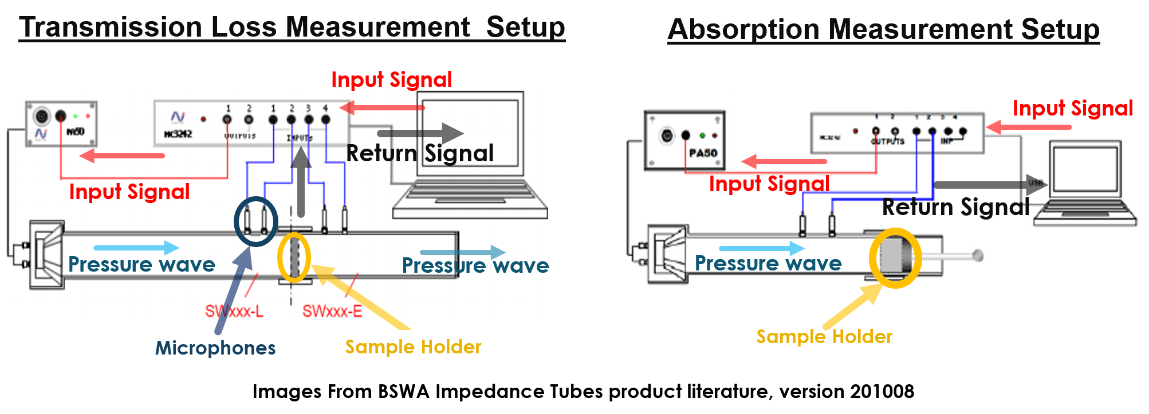
Impedance Tube Measurement Setup
Note: End of tube can be terminated with hard, soft, anechoic, or no boundary, depending on the type of measurement, and following e.g. ASTM procedures.

Slide 8
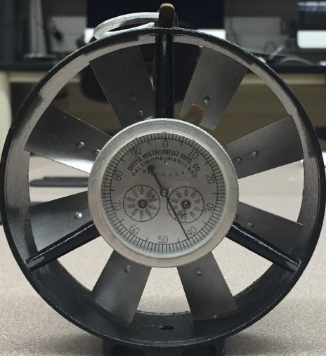
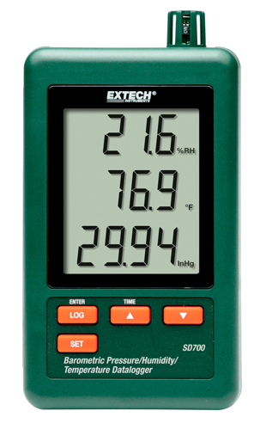
Other New Equipment
Anemometer measures the velocity of air flowing.
Volumetric flow rate can be determined by multiplying the velocity by the cross-sectional area
http://www.davis.com/Category/Intrinsically_Safe_Vane_Anemometers/65780
Barometric/Temperature/Relative Humidity Sensor
Used mainly for impedance tube calibration
Specs:
Barometric Pressure
0.29 to 3248 inHg
Resolution: 0.1 hPa
Temperature
32 to 122°F (0 to 50°C)
Resolution: 0.1°F(°C) / ±1.5°F (0.8°C)
Relative Humidity
10 to 90% RH
Resolution: 0.1% / ±(4% of rdg + 1% RH)

Slide 9
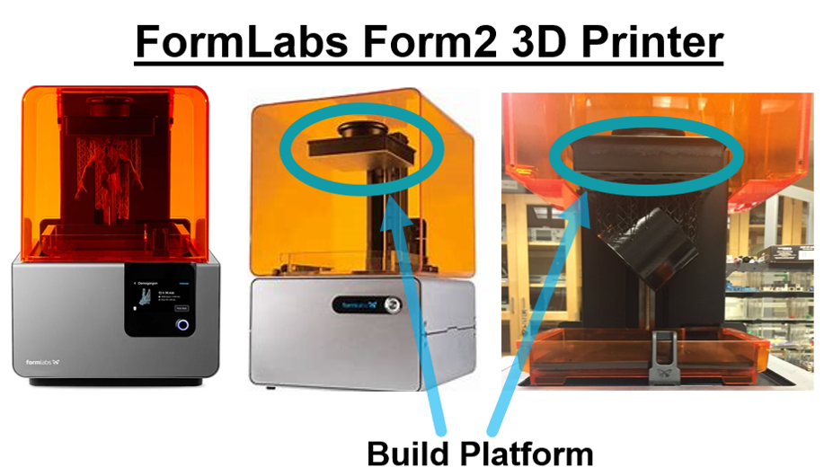
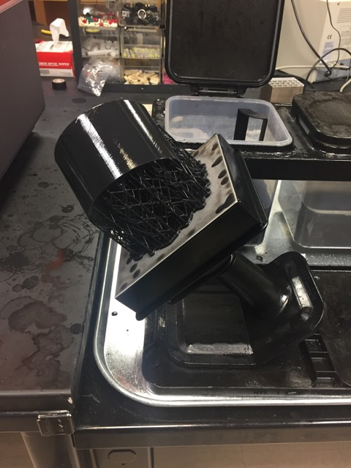
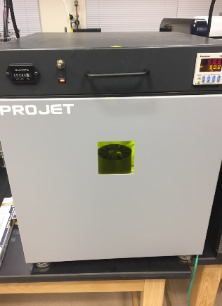
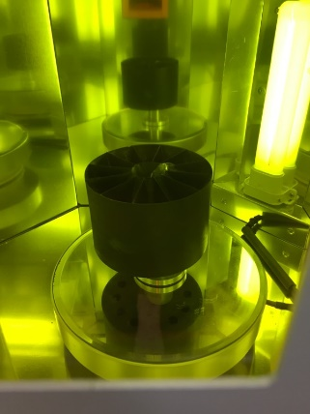
3D Printing Capabilities in UNCC
Center of Optoelectronics & Optical Communications
After Print Processing of 3D Model
Remove the supports and base. Use Isopropyl Alcohol to rinse the resin off the model
Use Ultraviolet Oven to Cure the Model
Prints the 3D Model upside down, on the build platform
FormLabs Form2 3D Printer Specs.
Max. Build Volume: 145 × 145 × 175 [mm]
Layer Thickness: 0.025 [mm]
Laser Spot Size: 0.14 [mm]
Form2 Black Printer Resin
Methacrylate Photopolymer Resin
Mixture of methacrylic acid esters, photoinitiators, proprietary pigment and additive package

Slide 10
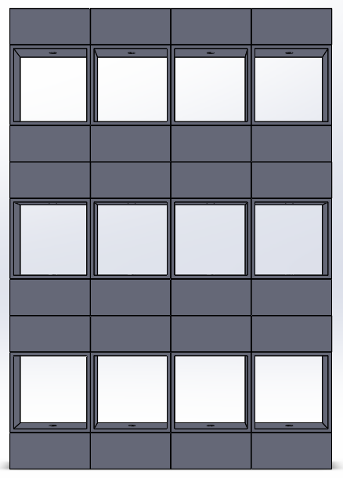
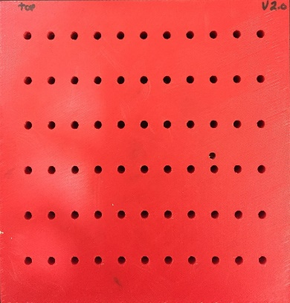
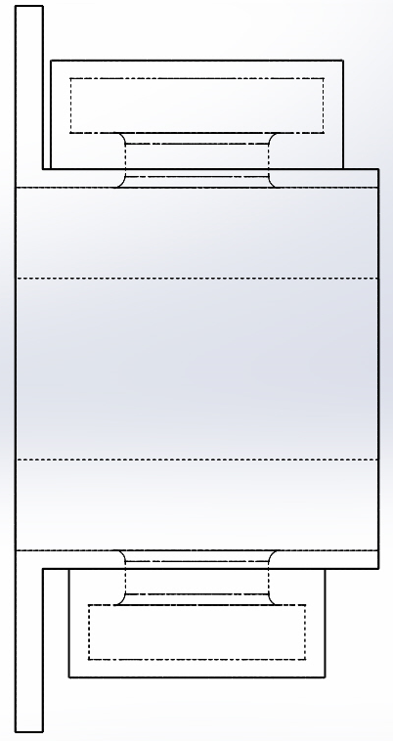
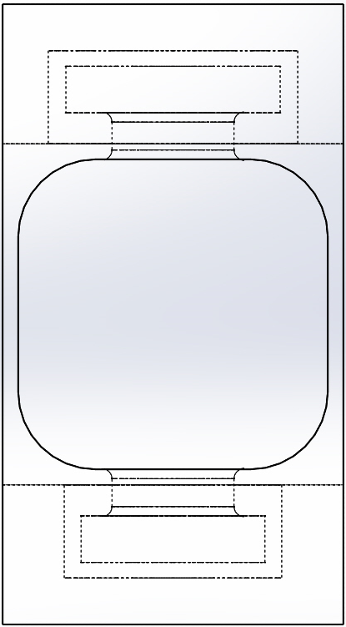

Original Samples (2017/2018)
Old Design had lots of wasted space between the resonators (Dead Space)
The resonator’s had a cylinder shaped cavity
This is an optimization problem, where we need to reduce the dead space and fit as many resonators into the sample as possible
Using non-traditional resonator cavity shapes can reduce the dead space.
Original Sample (2017):
Large “dead volume”; lower number of resonators per unit volume; 20 mm thick
Side View of Cell
Front View of Cell
182 mm
174 mm
Cylinder Shaped Resonators
Air Flow Channel (Waveguide)
$f_{resonance}= \frac{C}{2π} \sqrt{\frac{S}{V(l+∆l)}}$

Slide 11
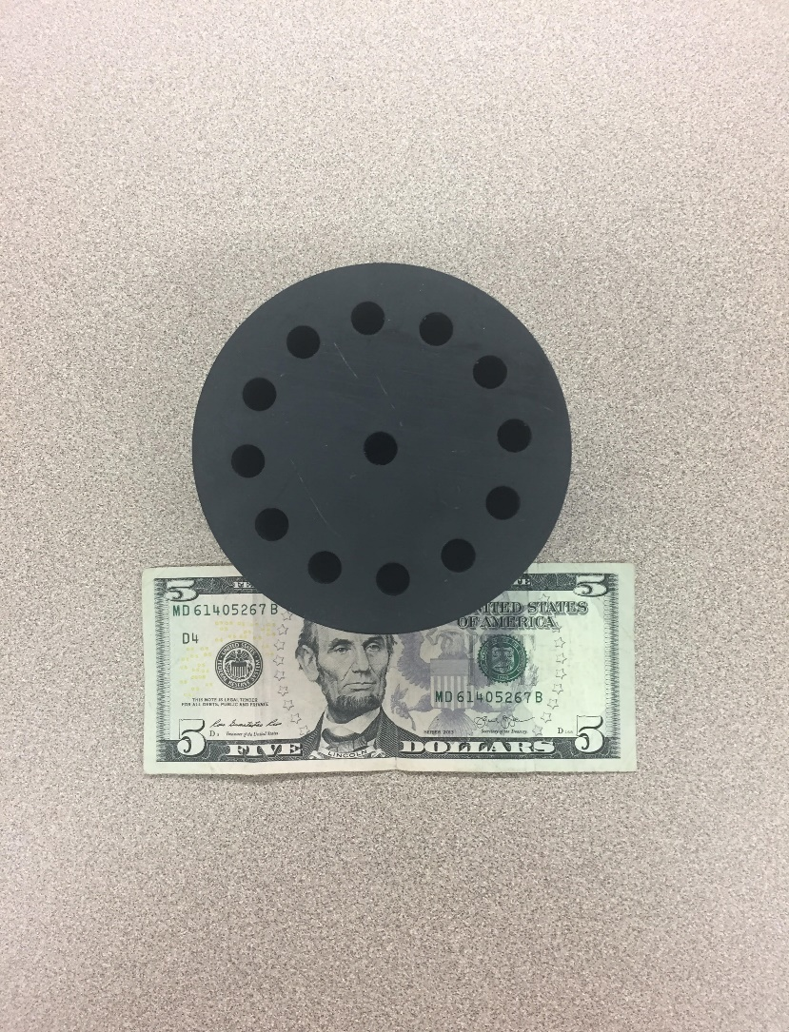
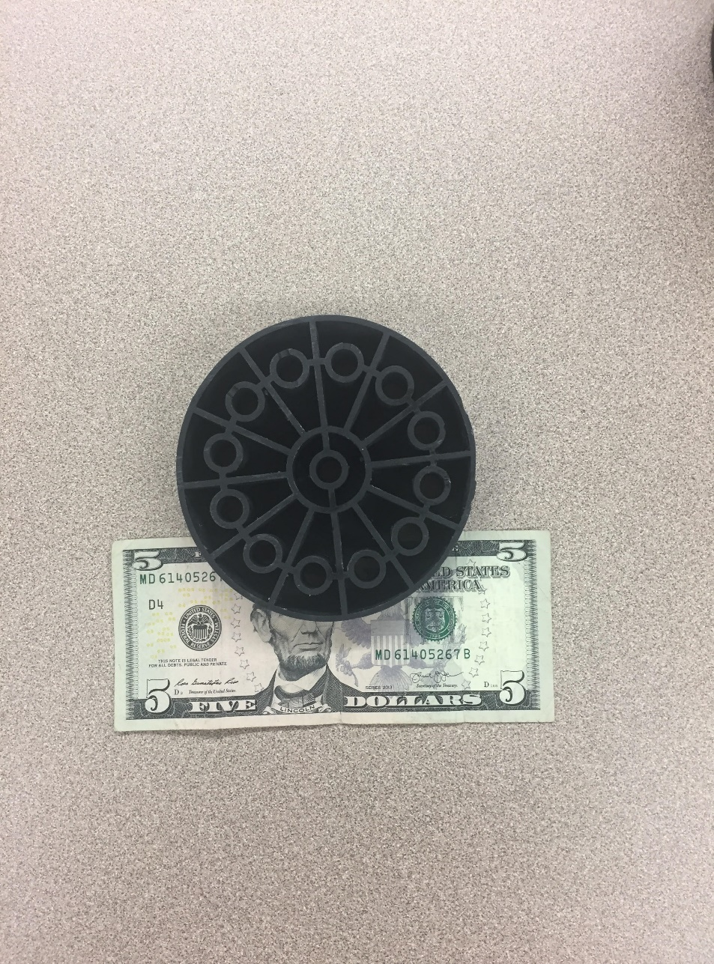
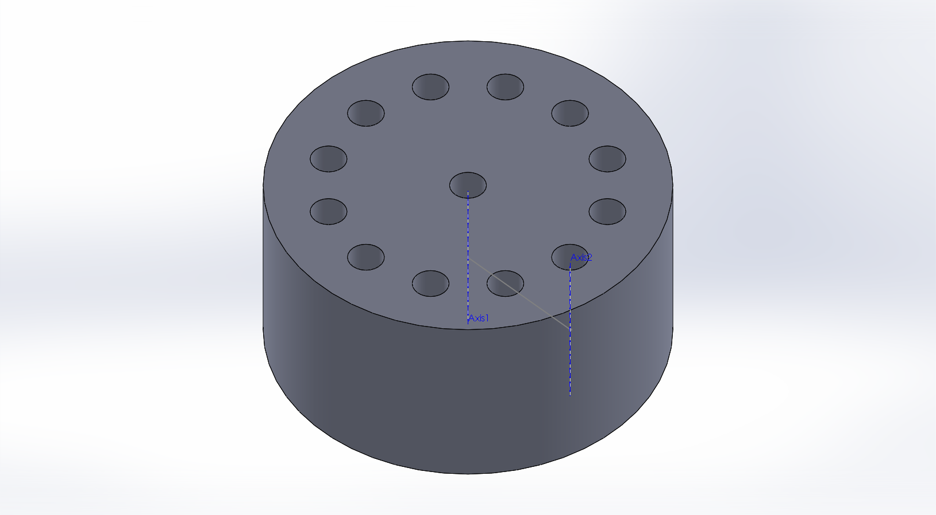
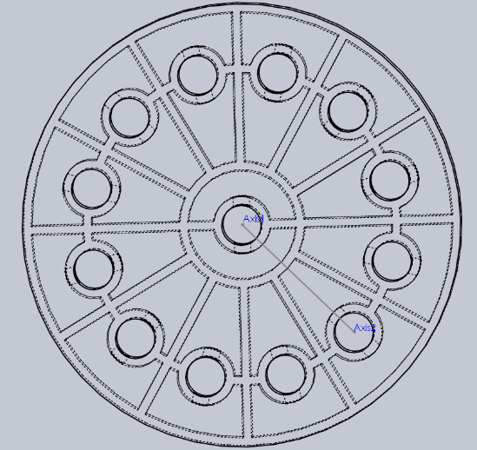

Current sample: optimized number of resonators per unit volume
Shape of resonators tailored to fill available volume.
New sample & cross section
SolidWorks® Design
Outer Resonator
100 mm
Inner Resonator
Waveguide
Current sample specifications
Face Diameter: 100 [mm]
13 waveguides with 9[mm] openings
Waveguide openings are 13*9²/100² or 11% of face area
Depth: 50 [mm]
Volume per Resonator: 7176 [mm³]
Resonance Frequency: ~983 [Hz]
$f_{resonance}= \frac{C}{2π} \sqrt{\frac{S}{V(l+∆l)}}$

Slide 12
Current Sample Transmission Loss Without Flow (no Fan)
Transmission Loss of New Sample
Transmission Loss of Blank Sample
Impedance tube transmission loss measurement
Current sample shows TL of 44 dB at ~1006 Hz, with a satellite peak of 33 dB at ~976 Hz.
Blank sample (waveguides w/no resonators) shows no structured TL

Slide 13
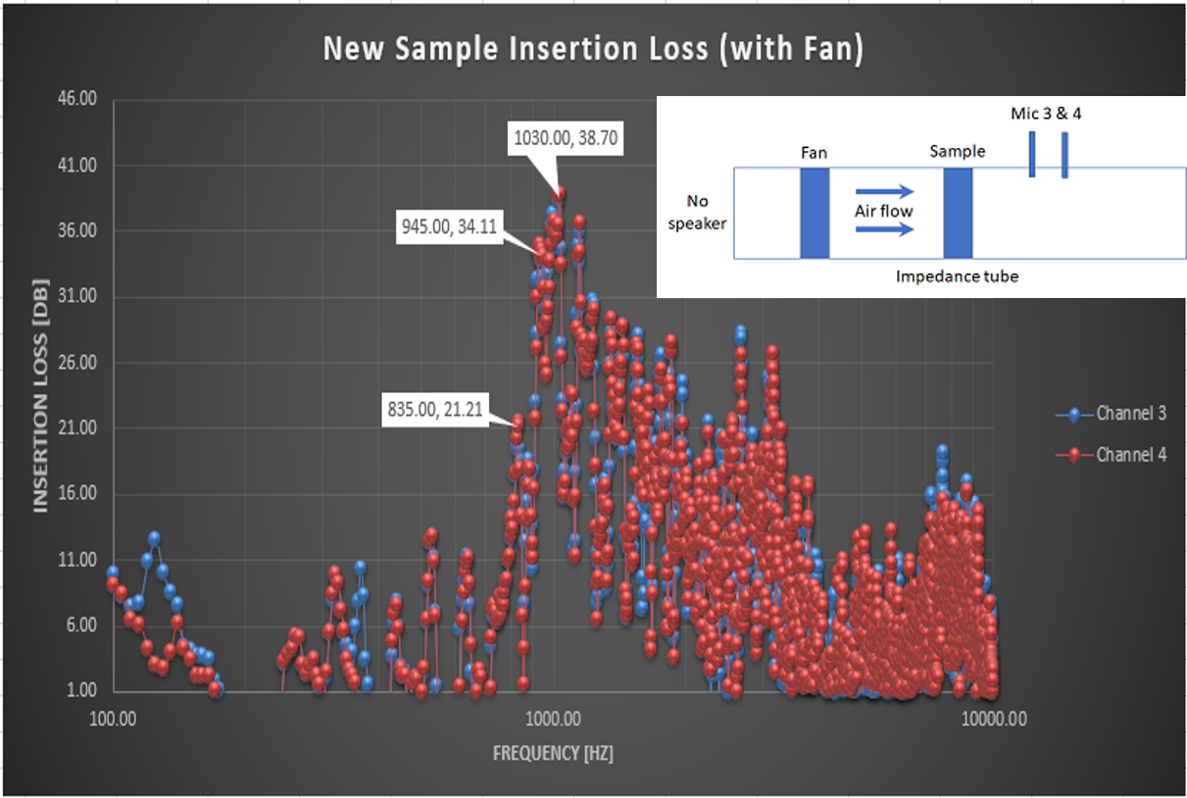
Current sample “insertion loss” with flow (Fan)
Experimental Setup
Used the 100 [mm] impedance tube and the channel 3 & 4 microphones.
No speaker was used; the fan is the only source of sound.
Fan holder was placed into the impedance tube on the source-side of the sample.
Results of New Sample
The Insertion Loss has a bandwidth of ~125 [Hz] and has a range from 925 [Hz] to 1050 [Hz].
Note:
Insertion Loss (this experiment) is the reciprocal ratio of the signal power delivered to a point due through an acoustical device to that of the signal power delivered to the same point before the acoustical device was inserted
Transmission Loss (previous pages) is the difference between the “incident power on an acoustic device and that transmitted downstream into an anechoic termination” [1]. (“The decrease in power that occurs during transmission from one point to another”[2])
[1] https://en.wikipedia.org/wiki/Transmission_loss_(duct_acoustics)
[2] https://www.owenduffy.net/transmissionline/concept/iltl.htm
ASTM transmission loss from previous page

Slide 14
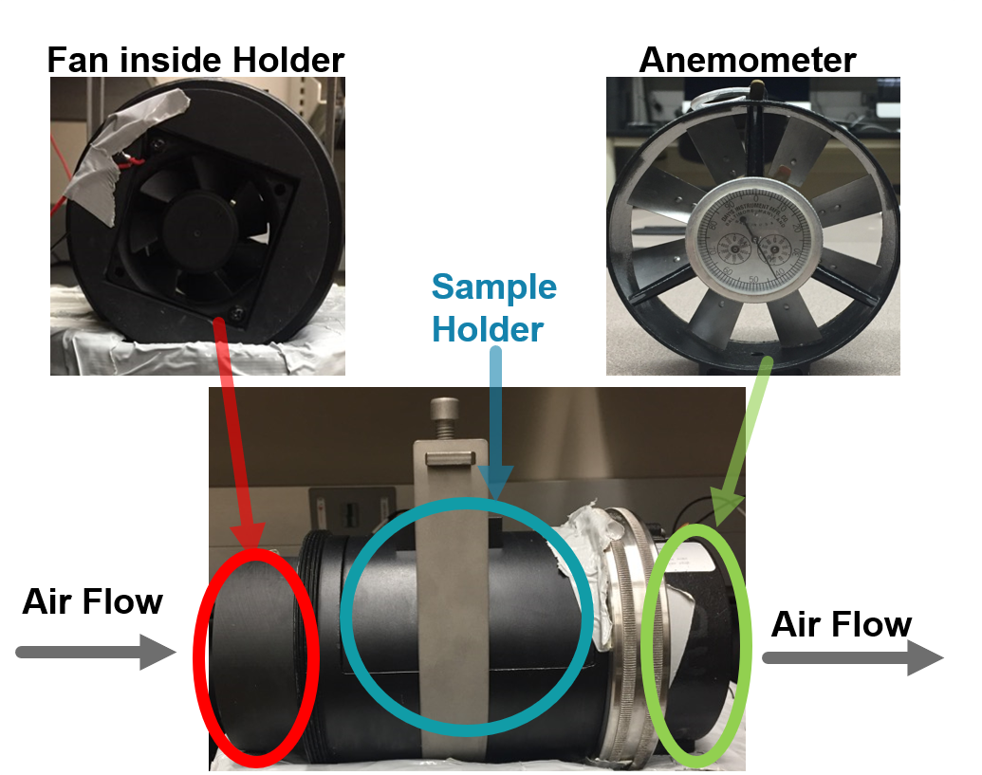
Anemometer Flow Measurements
 | 12 V (Fan Operating Voltage)
Without Sample | 1247 [Ft/min]
With Sample | 301 [Ft/min]
Assuming uniform flow (maybe not a good assumption), only ~24% of the air flow from the fan gets through the sample.
However, the area of the waveguide openings in only 11% of the face of the sample, so 24% is pretty good by comparison.
The new sample design attempts to improve the flow by providing tapered flow channels covering the entire face of the sample.

Slide 15
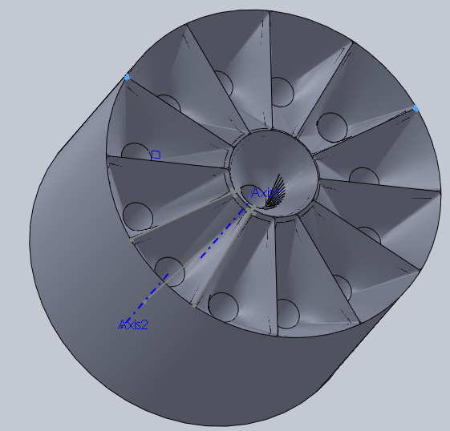
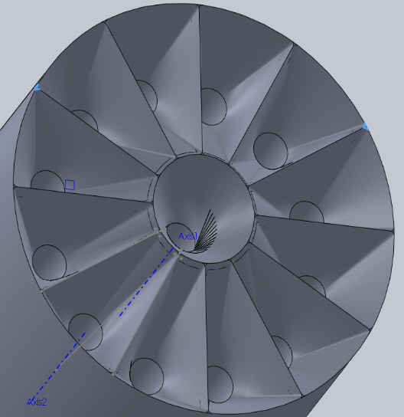
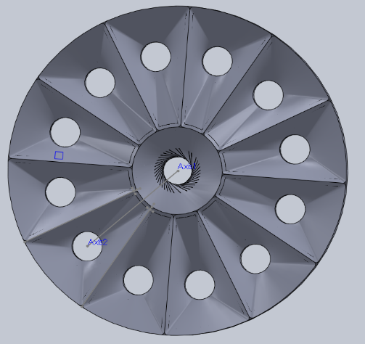
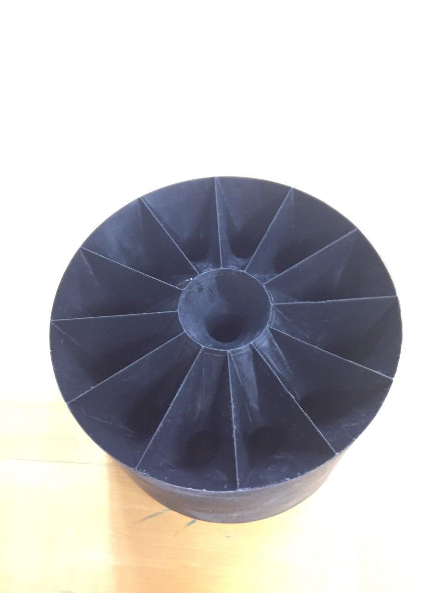
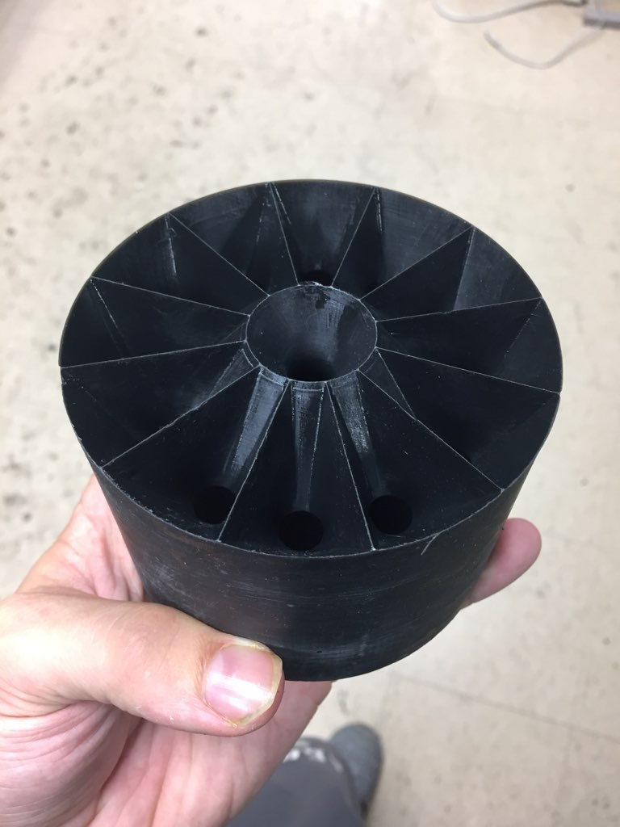
New flow-enhanced design
The tapered input channel serves as a nozzle and should allow for a higher fraction of air to flow through the waveguides
Increasing the depth of the tapered section should decrease drag, but at the expense of overall sample size.
New Design SolidWorks® Model
New Design 3D Model

Slide 16
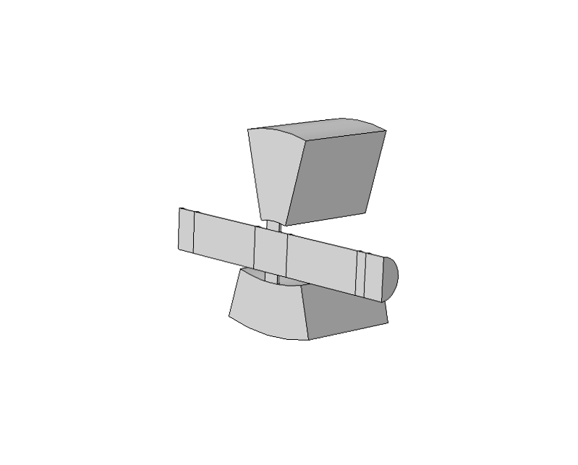
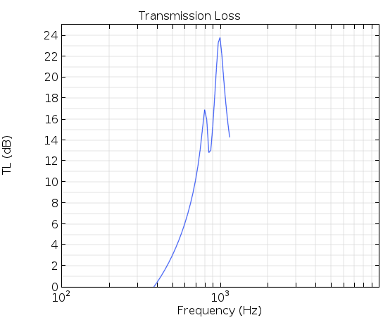
COMSOL® Simulations
COMSOL® Model for New Sample
New COMSOL® Software
LiveLinkTM for SolidWorks®
Load SolidWorks® files natively into COMSOL®
Edit the SolidWorks® files in COMSOL®
Upcoming Simulations
Simulation for the current sample design and the new
flow-enhanced design
Currently still on the SolidWorks® LiveLinkTM learning curve
Outer Resonator
Inner Resonator
Initial COMSOL® results
Resonance Peak is seen at:
~ 1000 [Hz]
~ 800 [Hz]
Volume of the inner and outer resonators are slightly different in first iteration.
This was due to an oversight when making the SolidWorks model

Slide 17
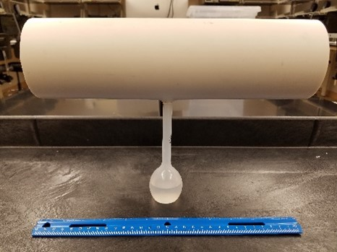
Upcoming conference presentation
Preliminary (non-proprietary) demonstration & simulation results (from 2017) on macroscopic models are being presented at the Comsol Conference in Boston next week (10/3/2018)
No disclosure of new results presented here today
Hill & Stokes, “Resonance frequency of Helmzoltz resonator”, Comsol Conference, 2018
% of Cavity filled w/ Water | Calculated Resonance Frequency | Measured Resonance Frequency | Percent Error
0 % | 175 Hz | 187 Hz | 6.85 %
20 % | 196 Hz | 206 Hz | 5.10 %
40 % | 226 Hz | 234 Hz | 3.54 %
50 % | 248 Hz | 254 Hz | 2.42 %
60 % | 277 Hz | 282 Hz | 1.81 %
80 % | 392 Hz | 387 Hz | -1.28 %
100 % | N/A (INF) | 459 Hz | N/A

Slide 18
Acknowledgements
This work was supported by the NSF Industry/University Cooperative Research Center for Metamaterials.
http://www.centerformetamaterials.org/
http://www.nsf.gov/

